Slide 1
ANKLE, INVERSION AND EVERSION JOINTS
BY
DR. OGWUCHE ELIJAH
(BSc. MSc. MB,BS)
LAGOS STATE UNIVERSITY COLLEGE OF MEDICINE (LASUCOM),IKEJA.

Slide 2
OUTLINE
INTRODUCTION
ARTICULATING SURFACES
ARTICULAR CAPSULE
SYNOVIAL CAPSULE
LIGAMENTS
MOVEMENT
STABILITY
BLOOD SUPPLY
NERVE SUPPLY
BOHLER’S ANGLE
APPLIED ANATOMY
REFERENCES

Slide 3
INTRODUCTION
The ankle joint is a hinge type of synovial joint
Also called talocrural joint
Formed by three bones; tibia, fibula and talus
Inferior ends of tibia and fibular and the superior surface of talus
The tibia and fibula form a bracket socket called MORTISE
The talus fits into the mortise to form the ankle joint

Slide 4
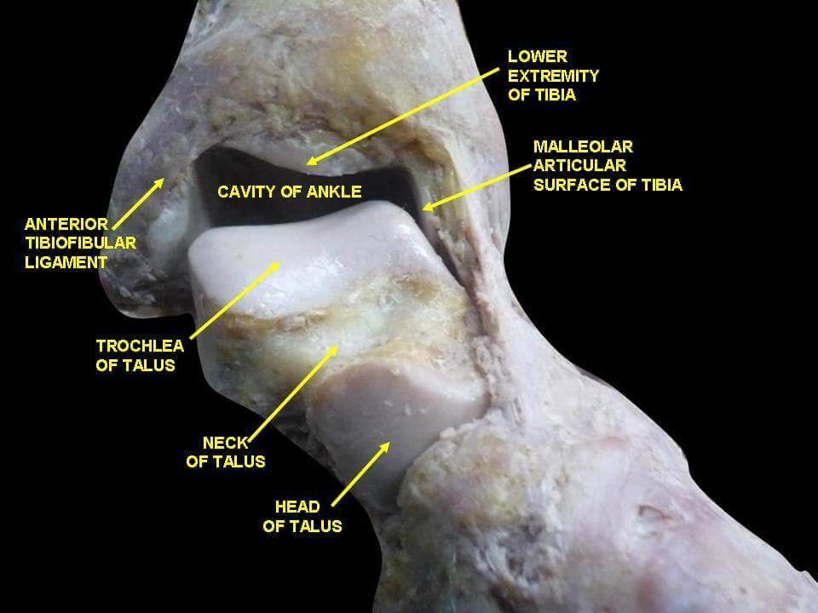
ARTICULATING SURFACES

Slide 5
ARTICULATING SURFACES
The trochlea notch of the talus fits into the deep bracket socket (mortise) formed by the inferior ends of tibia and fibula
The articulating surfaces are covered by hyaline cartilage
The trochlea bears on the malleoli and the distal end of the tibia bears a notch

Slide 6
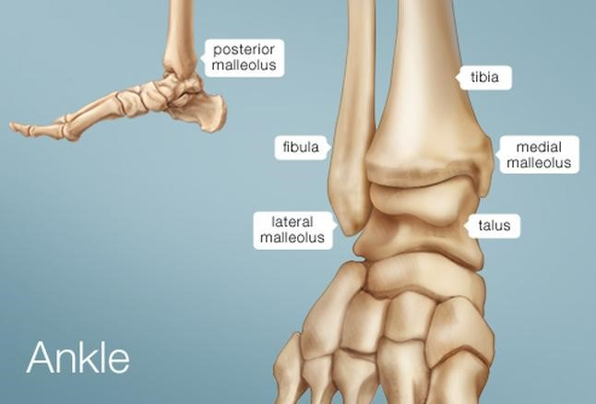
ARTICULATING SURFACES

Slide 7
ARTICULAR CAPSULE
The articulating surface is lined by fibrous capsule
Attached to the articular margins of all three bones
Except the anterior part of the talus
It is attached to the dorsum part of neck of talus

Slide 8
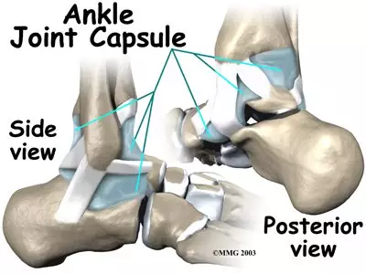
ANKLE JOINT CAPSULE

Slide 9
SYNOVIAL CAPSULE
This lines the fibrous capsule
It is attached to the articular margin of the talus and intracapsular part of the neck
It is attached to all articular margins

Slide 10
LIGAMENTS
Strong medial and lateral ligaments strengthen the joint
Medial ligament; This is also called deltoid ligament
. Very strong triangular ligament
. It is attached to medial malleolus and talus
. It has 3 parts;
Tibionavicular ligament
Anterior and posterior tibiotalar ligament
Tibiocalcanean ligament
.They hold the calcaneus and navicular bone against talus

Slide 11
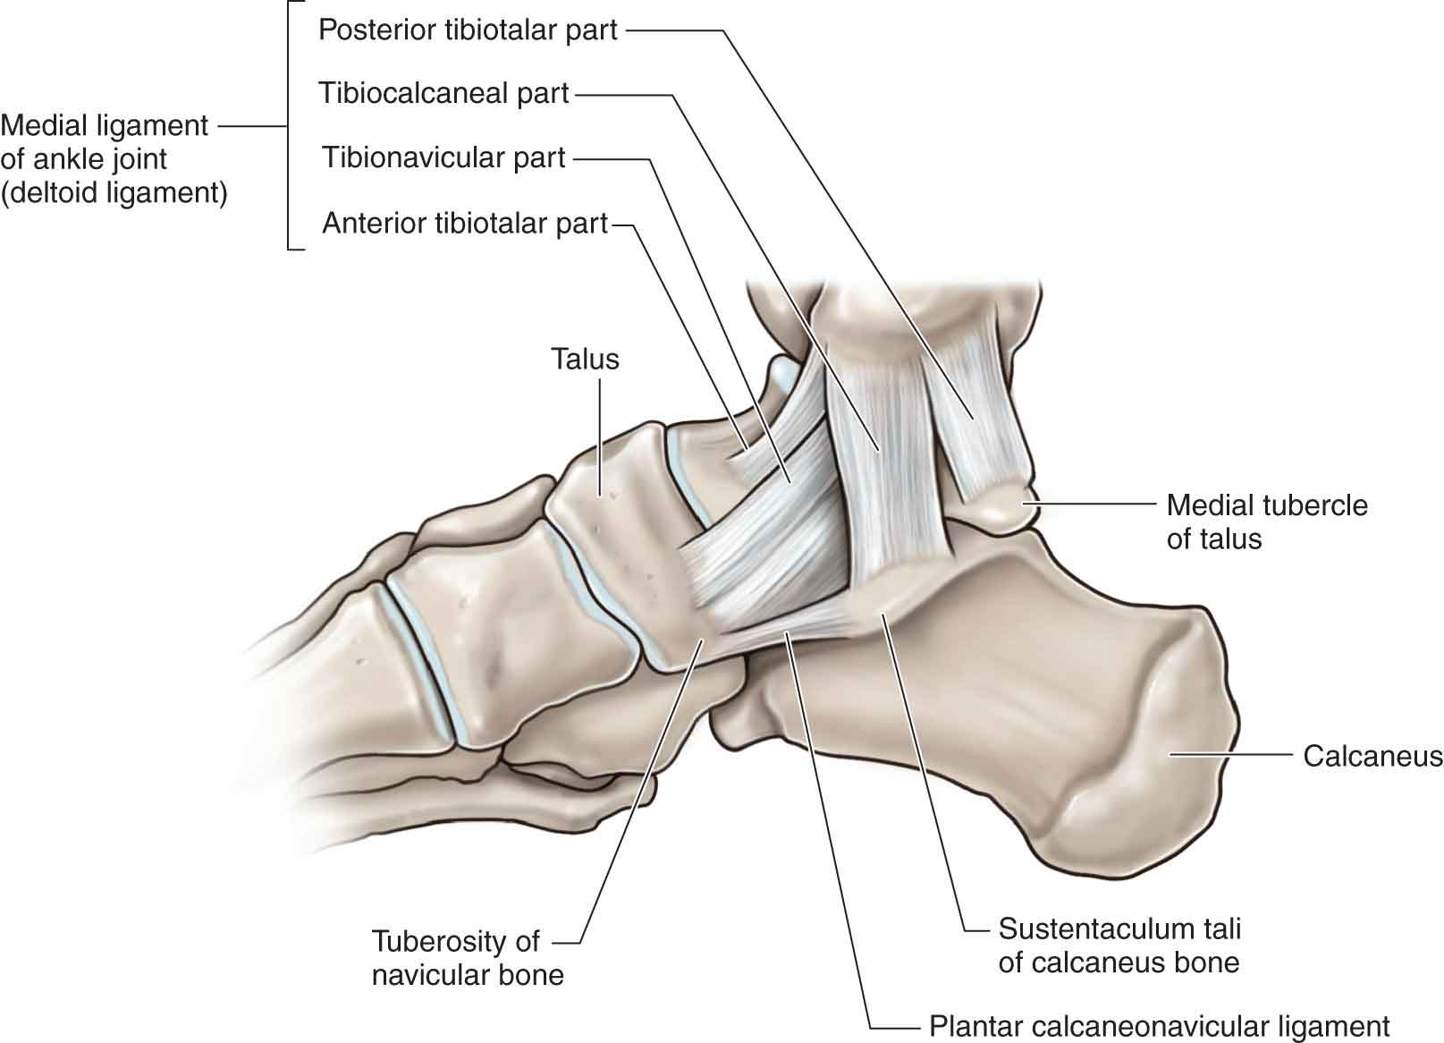
MEDIAL LIGAMENTS

Slide 12
LIGAMENTS
Lateral ligament;
. Attach lateral malleolus to talus and calcaneus
. It has 3 parts;
Anterior talofibular ligament
Posterior talofibular ligament
Calcaneofibular ligament

Slide 13
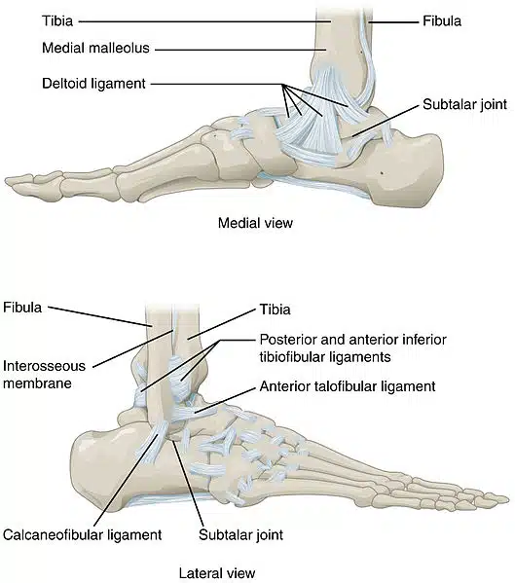
LATERAL LIGAMENT

Slide 14
RELATIONS OF ANKLE JOINT
ANTERIOR RELATIONS;
Muscles;
i. Tibialis anterior
ii. Extensor hallucis longus
iii. Extensor digitorum longus
iv. Peroneus tertius
Anterior tibial vessels
Deep peroneal nerves

Slide 15
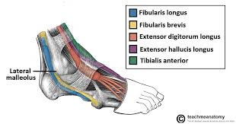
ANTERIOR RELATIONS

Slide 16
POSTERIOR RELATIONS OF ANKLE JOINT
POSTEROMEDIALLY;
Muscles;
i. Tibialis posterior
ii. Flexor hallucis longus
iii. Flexor digitorum longus
Posterior tibial vessels
Tibial nerve
POSTEROLATERALLY;
- Peroneus longus
- peroneus brevis

Slide 17
MOVEMENTS
The ankle joint is capable of being flexed and extended
The 2 active movements are; dorsiflexion and plantarflexion
Dorsiflexion; the foot is raised
Planter flexion; the foot is depressed
Principle muscles acting at ankle joint include;
Dorsiflexors; tibialis anterior, assisted by extensor digitorum longus, extensor hallucis longus and peroneus tertius
Plantarflexors; gastrocnemius and soleus, assisted by tibialis posterior, flexor hallucis longus and flexor digitorum longus

Slide 18
INVERSION AND EVERSION
These are side way movements that occour at the subtalar joint
The subtalar joint is formed between the talus and calcaneus
Eversion; movement of the foot laterally. There is dorsiflexion and abduction.
Muscles; fibularis longus, fibularis tertius, fibularis brevis
Inversion; the foot is medially rotated, there is plantar flexion and adduction.
Muscles; tibialis anterior, tibialis posterior

Slide 19
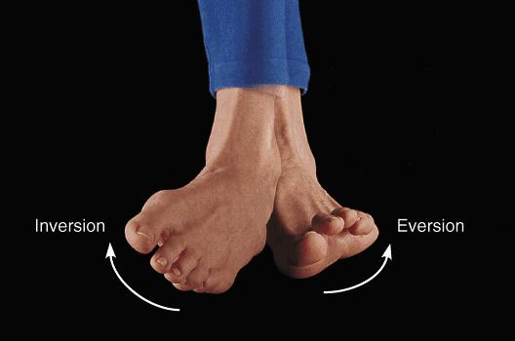
INVERSION AND EVERSION MOVEMENTS

Slide 20
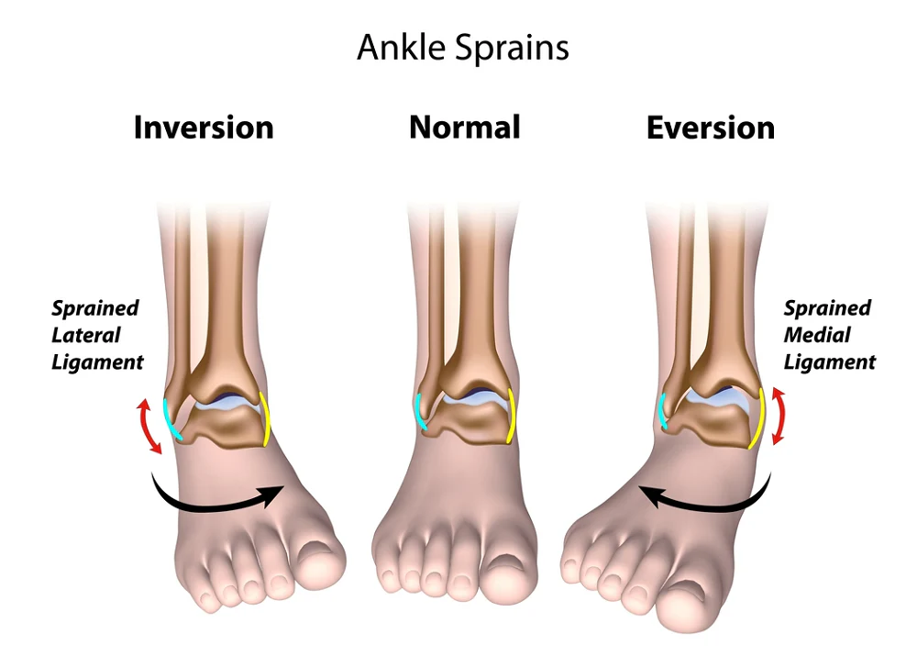
INVERSION AND EVERSION

Slide 21
STABILITY
The ankle joint is strengthened by ligaments and tendons that cross it bounded by thickenings of deep fascia retinacula.
It is most stable in dorsiflexion
Trochlea assists ankle in preventing posterior movement of foot in sudden jump.
The joint is unstable in plantar flexion

Slide 22
BLOOD SUPPLY
Articular arteries from;
Malleolar branches of fibular artery
Malleolar branches from anterior and posterior tibial artery
Peroneal arteries

Slide 23
NERVE SUPPLY
It receives its nerve supply from tibial nerve and deep peroneal nerve a division of coomon peroneal nerve
Occassionally, superficial nerves also supplies the ankle joint

Slide 24
APPLIED ANATOMY
Fractures and dislocation; forceful bending and twisting forces may result in fractures or dislocation of ankle joint. Tip of the lateral malleolus is avulsed
Ankle sprain; this is partial or complete tear in the ligaments of the ankle joint, may result from forceful abduction or adduction, affecting the collateral or lateral ligaments of the ankle joint
Pott’s fracture-dislocation; it is bimalleoli fracture. forceful eversion of the foot, pulling on the medial ligament, tearing off medial malleolus

Slide 25
REFERENCES
Hall, S. J. (2015). Basic biomechanics (7th ed.). New York, NY: McGraw-Hill Education.
Palastanga, N., & Soames, R. (2012). Anatomy and human movement: structure and function (6th ed.). Edinburgh: Churchill Livingstone.
Lippert, L. S. (2011). Clinical Kinesiology and Anatomy (5th ed.). Philadelphia, PA: F. A. Davis Company.
Standring, S. (2016). Gray's Anatomy (41st ed.). Edinburgh: Elsevier Churchill Livingstone.
Moore, K. L., Dalley, A. F., & Agur, A. M. R. (2014). Clinically Oriented Anatomy (7th ed.). Philadelphia, PA: Lippincott Williams & Wilkins.
Nordin, M., & Frankel V. H. (2012). Basic biomechanics of the musculoskeletal system (4th ed.). Philadelphia, PA: Wolters Kluwer Health/Lippincott, Williams & Wilkins.
Sabalbal, M, Johnson, M., McAlister, V. (2013), Absence of the genicular arterial anastomosis as generally depicted in textbooks. Annals of the Royal College of Surgeons, England, 95, 405–409.

Slide 26
THANK YOU, 4 LISTENING.

